Slide 1

archerysec.info
| @archerysec

Slide 2
About me !
I’m Anand Tiwari
Pentester – WebApp, MobApp & Network
Working @ Philips Healthcare on Securing Medical Devices.
4+ Years of Experience in InfoSec.
I love Automation for repeated work.
Interested in Offensive security.
Bug Hunter on Internet – disclosed vulnerability @Google, @Facebook, @Twitter etc.

Slide 3
What is Archery Tool ?
Open Source Vulnerability Assessment and Management Tool.
Automate Vulnerability Scanners.
Vulnerability data Dashboard.
Helping you on Managing Vulnerabilities.
Useful for Pentesters & Developers.
Easy to integrate in CI/CD environment.
Build in Python using Django.

Slide 4
Challenges in VA/VM
Multiple scanners.
Manage huge list of vulnerabilities.
Analysis and removing false positive.
Prioritizing vulnerabilities.
Tracking vulnerability mitigation.
Managing data from multiple scanners.
Organizing Periodic scans.

Slide 5
Archery Solution
Scanning using multiple scanners.
Web Application dynamic Authenticated scanning.
Collect all raw scan data in one place from multiple scanners.
Provide you on Managing vulnerabilities.
Helping you on Prioritizing vulnerability mitigation.
Manage your periodic scans.
Statistical analysis dashboard of your periodic scans.

Slide 6

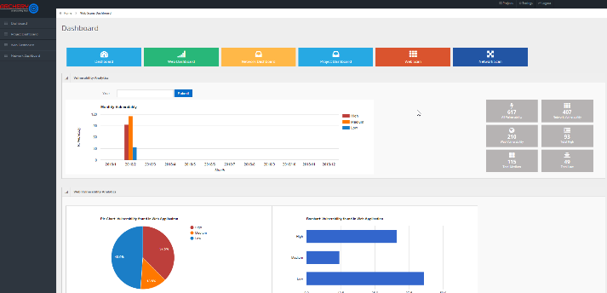





How Archery works ?
Scanners
Archery Database
Dashboard
ZAP Data
Burp Data
Archery Result Parsing
OpenVAS Data

Slide 7
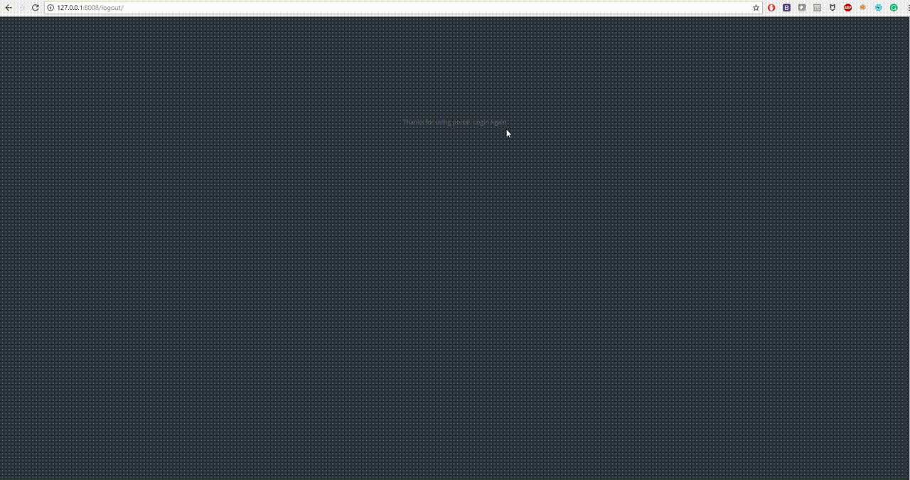
Dashboard

Slide 8
Scanners Supported
OWASP ZAP Scanner.
Burp scanner.
OpenVAS scanner.
Arachni Scanner.

Slide 9
Archery Demo !

Slide 10
Roadmap
More open source and commercial tool plugin support.
API Scanning and management.
Perform Reconnaissance before scanning.
Concurrent scanning.
Vulnerability PoC pictures.
Cloud security scanning.
Reporting Format.
Archery API python package.

Slide 11
How to Contribute ?
Test Archery Tool
Write scanners plugin or suggest us scanner support.
Use / Promote / write about the tool.
Report issue & feedback @ https://github.com/archerysec/archerysec/issues

Slide 12
Documentation
http://www.archerysec.info
https://archerysec.github.io/archerysec/
https://archerysec.github.io/archerysecapi/

Slide 13
Contact
Twitter - https://twitter.com/archerysec
Facebook - https://www.facebook.com/ArcherySec/
GitHub - https://github.com/archerysec/

Slide 14
Core Contributors
Anand Tiwari (@anandtiwarics)
Kudos to
Shubham Mittal (@upgoingstar)
Sudhanshu Chauhan (@sudhanshu_c)
Himanshu Kumar Das (@mehimansu)

Slide 15
QUESTIONS ?

